Slide 1
AI Sprint
TEMPEST · SPRINT REFRESHER
Three weeks on dusty-plasma data: automated access, a tracking benchmark, and a test for forces beyond pairwise.
3 weeks
6 people plus AI agents
4 workstreams
Notes:
Refresher on the sprint plan in burton-sprint/docs/SPRINT_PLAN.md, drafted 9 November 2026. Updated 11 November with Justin’s answers and the additional datasets Eva reported. Status: draft; the beyond-pairwise workstream needs re-scoping with Justin.

Slide 2

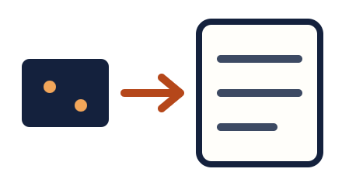
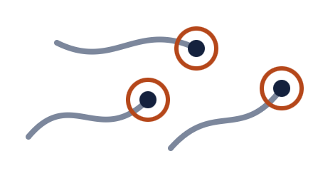
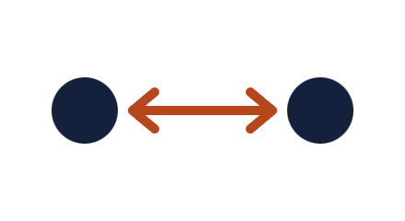
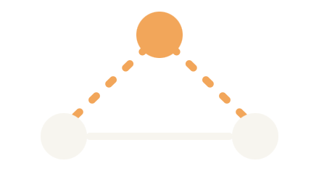


From camera frames to a closure test
THE SPRINT IN ONE PICTURE
Burton lab
A · Data access
B · Tracking
C · Baseline
D · Closure test
1. Raw image stacks from the camera
2. Automated pull through an MCP server
3. Images to 3D tracks, with trackers compared
4. The paper’s pairwise force model
5. Is pairwise enough, or does a third particle matter?
Ground truth from simulation feeds steps 3 and 5
Simulated particles with known positions and known forces: rendered into synthetic images to score the trackers, and used as controls to calibrate the closure test.
Notes:
The picture reads left to right. Justin’s lab supplies raw camera frames. Workstream A makes them reachable by code and agents. Workstream B turns frames into 3D particle tracks and compares tracking methods. Workstream C runs the paper’s pairwise model as the baseline. Workstream D asks whether pairwise is an adequate closure: in the last drawing, the solid line is the pair force the paper models, and the dashed lines are the possible influence of a third particle that the paper never tested. Underneath, simulations with known answers provide ground truth in two places: synthetic images for the tracking benchmark, and negative and positive controls for the closure test. Candidate simulators are our own, the lab’s validation code if Justin shares it, and DRIAD from Baylor. Output: a working pipeline, a tracker scorecard, and a short report.

Slide 3
The paper the sprint builds on
THE STARTING POINT
Yu, Abdelaleem, Nemenman and Burton, “Physics-tailored machine learning reveals unexpected physics in dusty plasmas,” PNAS 122(31), 2025.
5
8000 fps
R² > 0.99
experiments, each with 9 to 18 particles tracked in 3D
camera with a scanning laser sheet, giving 200 volumes per second
on held-out data, from three small networks fit with a weak-form loss
Limits the paper states about itself
Pairwise forces are assumed, in the model and its validation simulation, and never tested.
Mis-tracked particles “can have a detrimental effect.”
Non-reciprocity shows up below about 0.6 mm, where tracking is hardest.
Notes:
The model has three networks: pairwise interaction, environment force, and damping. Test R² ranges from 0.991 to 0.996 across the five runs. Findings include non-reciprocal forces, a charge–mass exponent that varies with pressure, and a screening length that depends on particle size. Error bars cover model variance only, not bias. Only horizontal force components are inferred. The public repo has no simulator and no simulated trajectories, so the validation simulation is something to ask Justin for. The lab’s public repo has the force-inference code and the five tracked trajectories, but no tracking code, no raw images, and no license. Justin is sending a cleaned-up version of the code directly; it is not public until their next paper.

Slide 4
Three things the sprint adds
BEYOND THE PAPER
1
2
3
Automated data access
A tracking benchmark
A beyond-pairwise test
An MCP server gives code and AI agents read-only access to Justin’s TIFF image stacks.
Alternative image-processing and tracking methods scored against the lab’s TrackPy pipeline.
Is the pairwise force law an adequate closure, or do many-body and history-dependent forces matter?
Scope to confirm with Justin
Deliverable: a working pipeline from TIFFs to trajectories to a verdict, a tracking scorecard, and a short report that includes failures.
Notes:
Out of scope: vertical forces, the origin of the pressure-dependent charge–mass exponent, a full reproduction of every number in the paper, and comparison with the other bake-off model families. These are natural follow-ons. Justin asked for questions orthogonal to the lab’s force-inference work, because not all of its authors are part of TEMPEST. Items 1 and 2 are clearly orthogonal; item 3 is the one to re-scope with him.

Slide 5
Four workstreams, six people
THE PLAN
Workstream | Weeks | People | What it produces
A. Data access | 1 | 1 | The MCP server for the TIFFs, plus a plain Python loader on day 2 so nobody waits
B. Tracking benchmark | 1 to 3 | 2 | Synthetic image stacks with known positions, and a scorecard of trackers
C. Pairwise baseline | 1 | 1 | The lab’s updated code running on its own data, and a simulator with switchable physics
D. Beyond pairwise | 2 to 3 | 1 | Many-body verdict; scope to confirm with Justin
Staffing gap: the team covers ML, scientific computing and physics, with no image-processing or infrastructure specialist, which A and B need most.
Notes:
The lead is the sixth person. Workstream C now waits for the code Justin sends, which must stay out of the public repo. Workstream D is the one Justin’s request for orthogonal questions affects. The lead owns scope, contact with the Burton lab, physics judgment and the report. The two physics people should own the simulator and the interpretation of any claimed effect. Tracking scope is held to a small number of methods done carefully. If someone with particle-tracking experience can be borrowed, workstream B is where they go.

Slide 6
Three weeks, three checkpoints
THE PLAN
WEEK 1
WEEK 2
WEEK 3
Get set up
Build and calibrate
Real data and report
Characterize the TIFF stack; loader on day 2, MCP server by day 5
Forward image model and a baseline TrackPy run
Lab’s updated code runs on its data; simulator built
Alternative trackers; synthetic test set frozen; first scorecard
Beyond-pairwise tests run on simulation only
Detection thresholds set from the controls
Trackers on real runs; effect of tracking error on inferred forces
Tests applied to the experimental trajectories
Results frozen on day 13; then writing
Data: Justin will start us on the raw version of the published data. If it has not arrived by day 3, work continues on synthetic images and the published trajectories.
Notes:
Checkpoints. End of week 1: data reachable, baseline runs, simulator exists. End of week 2: the controls behave as designed, or the science scope is cut back. Day 13: results frozen and the remaining time is writing. No start date has been set.

Slide 7
The pairwise force law is a closure
WHY IT MATTERS FOR TEMPEST
Retained state
Eliminated information
Dust particle positions and velocities.
The ions, electrons and neutrals of the plasma.
Classical reduced operator
Closure defect
Pairwise effective force, environment force and damping: the paper’s model.
Many-body terms from overlapping ion clouds, and memory from wake relaxation.
The paper assumes this closure and never tests it
The model sums pair forces, the validation simulation is pairwise too, and there is no bound on many-body effects. DRIAD resolves the ions, so there the defect can be computed directly. Eva, Saikat, and Lorin all have additional data to test closure models.
Notes:
The paper says forces “are expected to be pairwise to leading order” and builds that into the architecture: a third particle’s position never enters, so no many-body term can be learned. Its supporting information describes the validation simulation as using “a pairwise, non-reciprocal repulsive force.” The high R² caps the unexplained force overall, but a many-body effect could be absorbed into the environment or pair force. This is the effective-interaction stage of the bake-off’s dusty-plasma ladder. Keep two closures apart: the force-level one here (truncating the effective interaction at pairs) and the statistics-level one (closing the correlation hierarchy at pair correlations, where the Hani cumulant diagnostics apply). Any augmented model must recover the pairwise one at low density and large separation. This framing may also help with Justin: testing a closure assumption is a different question from inferring forces with the lab’s method.

Slide 8

Controls first, experiment last
THE SCIENCE QUESTION · SCOPE UNDER REVIEW WITH JUSTIN
NEGATIVE CONTROL
POSITIVE CONTROL
ONLY THEN
Strictly pairwise simulation
Simulation with a planted effect
Experimental trajectories
The tests must find nothing. This sets the false-positive rate.
The tests must find it. This sets the detection threshold. DRIAD could serve here.
Residual structure, nested models, and three-particle correlations.
Three outcomes, all reportable
An effect above threshold · no effect, with an upper bound · inconclusive, because 9 to 18 particles cannot separate many-body effects from the environment force or tracking error.
Notes:
Justin asked for questions orthogonal to the lab’s force-inference work. As drafted, the nested-model tests extend the lab’s own architecture, so this workstream needs his agreement. Options: confirm it counts as orthogonal, restrict it to model-free diagnostics (residual structure and three-particle correlations), or replace the question. DRIAD, the Baylor simulation that resolves ions, could be an external control with known forces if data arrive by the end of week 1. Both controls are pushed through the same tracking noise as the real data. The tests, in order of cost: (1) do held-out residuals of the pairwise model depend on a third particle, local density, or recent neighbor motion; (2) nested models that add a density-conditioned pair force, a three-body term, or a short-memory term, compared at matched data and parameter count; (3) connected three-particle correlations, as defined in the Hani project. Inconclusive is a likely outcome and would define what data a follow-on experiment needs. Known confounders: environment force versus density-dependent pair force, charge–mass coupling, horizontal forces only.

Slide 9
More data (from Eva, et al.)
SANITY CHECKING DATA
Source | Held by | What it is
PK-4 tracks | Auburn, Baylor | Particle tracks from the ISS facility, 2D and lower-resolution 3D; non-Yukawa interaction
DRIAD simulation | Lorin | Dust and ions simulated together, so the true interaction potential is known
Velocimetry | Auburn | Dust velocity data from PK-4 and many lab experiments
Proposed handling, not yet agreed
Keep the sprint’s core scope on Burton’s data.
Use DRIAD as a stretch control with known forces.
Design the data access so PK-4 and DRIAD can be added later.
Coordinate with their students’ SINDy work, and join the data-formats meeting.
Notes:
Eva also said Auburn and Baylor are working with NASA to open-source PK-4 datasets, metadata and analysis codes through the PSI repository, and she proposed a quick meeting on data formats and standards so all groups provide consistent datasets. Their students are using sparse regression (SINDy) to learn the interaction potential, first from DRIAD and eventually from experiment, which overlaps with the sprint’s force-inference work. Still unknown for all three sources: formats, run counts, resolution and terms of use. Details are in shared/docs/dusty_plasma_data_sources.md.

Slide 10
Discuss during meeting 11 November
PROJECT SCOPE
Data
Code
Start with the raw version of the published data. New data, with full metadata, is also on offer.
He will send a cleaned-up, updated version directly. Not public until their next paper.
Metadata
Scope concern
Pressure, power and particle sizes are known. Laser-sheet phase was not recorded; it comes from a calibration.
Student who wrote the force inference algorithm is not in TEMPEST. Justin wants to make sure we ask orthogonal questions. Check this.
To settle with Justin and his students
What does “orthogonal” mean to him, and does beyond-pairwise qualify? · Does the code include tracking? · Can they share their validation simulation? · Data size, format and transfer · Old data or new?
Notes:
On “orthogonal”: ask what he means. Three readings: (a) don’t use or extend the lab’s force-inference code; (b) don’t do force inference on this data at all; (c) don’t duplicate what their next paper covers. Under (a) a model-free beyond-pairwise test is fine; under (b) or (c) it may not be. Point to make: the paper assumes pairwise forces, in the model and in its validation simulation, and never tests for or bounds many-body effects, so our question examines an assumption of their work and does not repeat it. On the simulation: the paper validated the method on a custom molecular-dynamics code with 15 particles, but the public repo has no simulator and no simulated trajectories. Ask whether they can share the code or its output, so our controls match their validation. It would not give image-level ground truth for the tracking benchmark. Justin suggested discussing on Wednesday with his students. Wentao, who took the published data, has moved on to a postdoc, which is why new data is the route to complete metadata. Data access and the tracking benchmark are clearly orthogonal to the force-inference work; the beyond-pairwise workstream, as drafted, extends the lab’s own model and is the part at risk. A fallback is to use model-free diagnostics only. Separately, Eva reported that Auburn and Baylor can offer PK-4 particle tracks, DRIAD simulations with known interaction potentials, and velocimetry data; the plan proposes DRIAD as a stretch control and keeping the core scope on Burton’s data. Eva also proposed a data-formats meeting. No sprint start date or role assignments yet.

